Slide 1
Relational Model

Slide 2
Why Study the Relational Model?
Most widely used model
IBM, Microsoft, Oracle, Sybase
Recent competitor : OO and OR models

Slide 3
Relational Model Foundation (1)
Relational Model of data is based on the concept of RELATION
A Relation is a Mathematical concept based on idea of SETS
The strength of the relational approach to data management comes from the formal foundation provided by the theory of relations

Slide 4
Relational Model Foundation (2)
The model was first proposed by Dr. E.F. Codd of IBM in 1970
A Relational Model for Large Shared Data Banks, Communications of the ACM, June 1970
The above paper caused a major revolution in the field of database management and earned Ted Codd the coveted ACM Turing Award in 1981

Slide 5
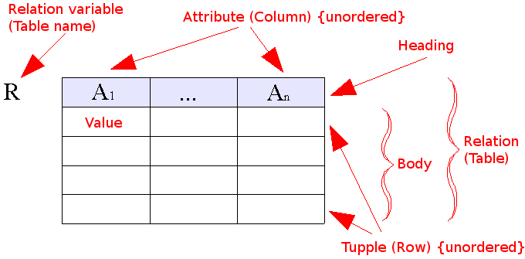
Relational Model (1970)
Data as set of tables
Having constraints and relationships
Oracle, DB2,Sybase

Slide 6
Some Terms
Informal Name
Table
Row or Record
Column or Field
No. of Rows
No. of Columns
Unique Identifier
Legal Values Set
Formal Name
Relation
Tuple
Attribute
Cardinality
Degree or Arity
Primary key
Domain

Slide 7
Relational Database: Definitions
Relational database: a set of relations
Relation: made up of 2 parts:
  Instance : a table, with rows and columns.
  #Rows = cardinality, #fields = degree / arity.
  Schema : specifies name of relation, plus name and type of each column.
    E.G. Students(sid: string, name: string, login: string, age: integer, gpa: real).
Can think of a relation as a set of rows or tuples (i.e., all rows are distinct).
Notes:
3

Slide 8
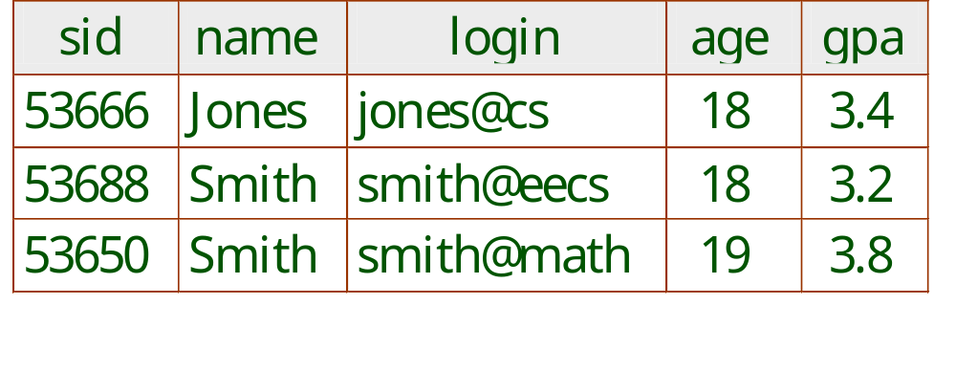
Example Instance of Students Relation
Cardinality = 3, degree = 5, all rows distinct
Notes:
4

Slide 9
Domains & Data Types
Smallest semantic of data
Individual Part Number, Individual Supplier number, Individual City name etc.
Atomic values or scalar values
Domain is a named set of atomic values
Pool of legal values
Example: Supplier number an integer [0, 10000]

Slide 10
Domains & Data Types (2)
Significance of domains
Domain-constrained comparisons
  Select …..
  From P, SP
  Where P.P# = SP.P#
  Select …..
  From P, SP
  Where P.weight = SP.qty
Both are valid queries in SQL, but second one makes no sense!!
Domains implemented as Data-Types?

Slide 11
Relational Systems
In relational systems, the DB is perceived by the user as relations & nothing else
Relations are only logical structures
At the physical level, the system is free to store the data in any way it likes – using sequential files, indexing, hashing…
Provided it can map stored representations to relations

Slide 12
Relational Systems (2)
Consider the relations:
Dept(dept#, dname, budget)
D1 MKTNG 10M
D2 DEV 12M
D3 RES 5M
Emp(emp#, ename, dept#, salary)
E1 LOPEZ D1 40K
There is a connection between tuples E1 & D1. The connection is represented, not by a pointer, but by the occurrence of value D1 in E1.
In non-relational systems, such information is typically represented by some kind of pointer that is visible to the user.

Slide 13
Relational Systems (3)
In relational systems, there are no pointers at the logical level
Pointers will be there at the physical level
Physical storage details are concealed from the user in relational systems

Slide 14
Properties of Relations
There are no duplicate tuples
    Body of a relation is a mathematical set
Tuples are unordered, top to bottom
    Body of a relation is a mathematical set
    No such thing as fifth tuple, next tuple ..
    No concept of positional addressing
Attributes are unordered, left to right
    Heading of a relation is a mathematical set
    No concept of positional addressing
All attribute values are atomic
    Normalized (1st Normal Form)

Slide 15
Types of Relations
Base Relations
    The original (given) relations
Derived Relations
    Relations obtained from base relations
Views
    “Virtual” derived relation
    Only definition is stored in the catalog
    Definition executed at run-time
Snapshots
    Values contained at a point of time
Query Result
    Unnamed derived relation

Slide 16
NULL Value
Null is missing or inapplicable information
Lack of value/information doesn’t mean value ‘zero’

Slide 17
Integrity Constraints
Data Integrity
  Key Constraints
  Domain (check) constraints
  Not null constraints
Referential Integrity
  Foreign Keys
Assertions
    A condition that the database must always satisfy
    Domain constraints and referential integrity constraints are special cases
    Every loan has at least one customer who maintains an account with a balance of minimum 10000.

Slide 18
Relational Query Languages
A major strength of the relational model: supports simple, powerful querying of data.
Queries can be written intuitively, and the DBMS is responsible for efficient evaluation.
  The key: precise semantics for relational queries.
  Allows the optimizer to extensively re-order operations, and still ensure that the answer does not change.
Notes:
9

Slide 19
The SQL Query Language
Developed by IBM (system R) in the 1970s
Need for a standard since it is used by many vendors
Standards:
  SQL-86
  SQL-89 (minor revision)
  SQL-92 (major revision)
  SQL-99 (major extensions, current standard)

Slide 20
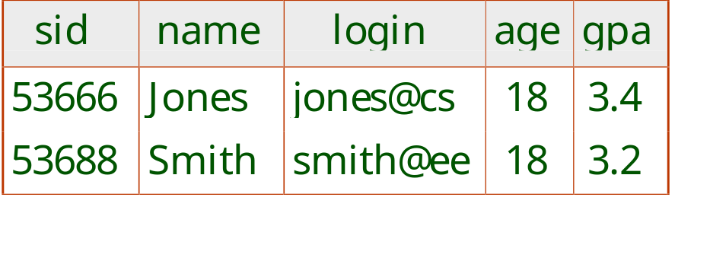
The SQL Query Language
To find all 18 year old students, we can write:
SELECT *
FROM Students S
WHERE S.age=18
To find just names and logins, replace the first line:
SELECT S.name, S.login

Slide 21
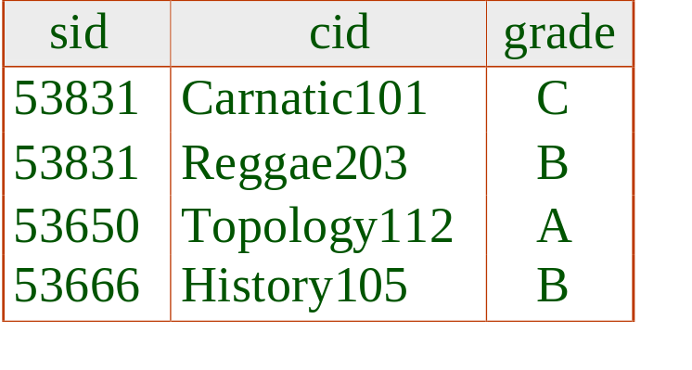
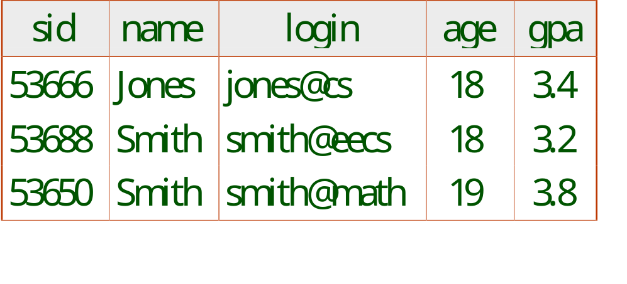
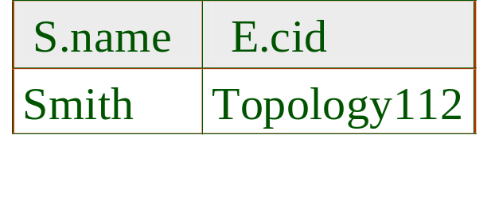
Querying Multiple Relations
SELECT S.name, E.cid
FROM Students S, Enrolled E
WHERE S.sid=E.sid AND E.grade=“A”
What does the query compute?
Given the following instances of Enrolled and Students:
we get:

Slide 22
Creating Relations in SQL
CREATE TABLE Students
(sid: CHAR(20),
name: CHAR(20),
login: CHAR(10),
age: INTEGER,
gpa: REAL)
Creates the Students relation. Observe that the type (domain) of each field is specified, and enforced by the DBMS whenever tuples are added or modified (domain constraints)
As another example, the Enrolled table holds information about courses that students take.
CREATE TABLE Enrolled
(sid: CHAR(20),
cid: CHAR(20),
grade: CHAR(2))
Notes:
15

Slide 23
Destroying and Altering Relations
DROP TABLE Students
Destroys the relation Students. The schema information and the tuples are deleted.
ALTER TABLE Students
ADD COLUMN firstYear: integer
The schema of Students is altered by adding a new field; every tuple in the current instance is extended with a null value in the new field.
Notes:
16

Slide 24
Adding and Deleting Tuples
Can insert a single tuple using:
INSERT INTO Students (sid, name, login, age, gpa)
VALUES (53688, ‘Smith’, ‘smith@ee’, 18, 3.2)
Can delete all tuples satisfying some condition (e.g., name = Smith):
DELETE
FROM Students S
WHERE S.name = ‘Smith’
Notes:
10

Slide 25
Integrity Constraints (ICs)
IC: condition that must be true for any instance of the database; e.g., domain constraints
  ICs are specified when schema is defined
  ICs are checked when relations are modified
A legal instance of a relation is one that satisfies all specified ICs
  DBMS should not allow illegal instances
If the DBMS checks ICs, stored data is more faithful to real-world meaning
  Avoids data entry errors, too!
Notes:
5

Slide 26
Primary Key Constraints
A set of fields is a key for a relation if :
  1. No two distinct tuples can have same values in all key fields, and
  2. This is not true for any subset of the key.
  Part 2 false? A superkey.
  If there’s >1 key for a relation, one of the keys is chosen (by DBA) to be the primary key.
E.g., sid is a key for Students. (What about name?) The set {sid, gpa} is a superkey.
Notes:
6

Slide 27
Primary and Candidate Keys in SQL
Possibly many candidate keys (specified using UNIQUE), one of which is chosen as the primary key.
“For a given student and course, there is a single grade.” vs. “Students can take only one course, and receive a single grade for that course; further, no two students in a course receive the same grade.”
Used carelessly, an IC can prevent the storage of database instances that arise in practice!
CREATE TABLE Enrolled
(sid CHAR(20)
cid CHAR(20),
grade CHAR(2),
PRIMARY KEY (sid,cid) )
CREATE TABLE Enrolled
(sid CHAR(20)
cid CHAR(20),
grade CHAR(2),
PRIMARY KEY (sid),
UNIQUE (cid, grade) )
Notes:
6

Slide 28
Foreign Keys, Referential Integrity
Foreign key : Set of fields in one relation that is used to `refer’ to a tuple in another relation. (Must correspond to primary key of the second relation.) Like a `logical pointer’.
E.g. sid is a foreign key referring to Students:
  Enrolled(sid: string, cid: string, grade: string)
  If all foreign key constraints are enforced, referential integrity is achieved, i.e., no dangling references.
  Can you name a data model w/o referential integrity?
Notes:
7

Slide 29
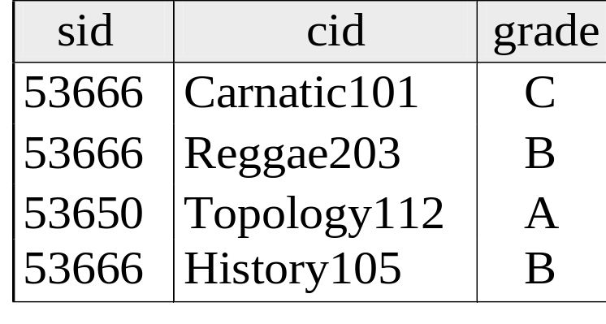
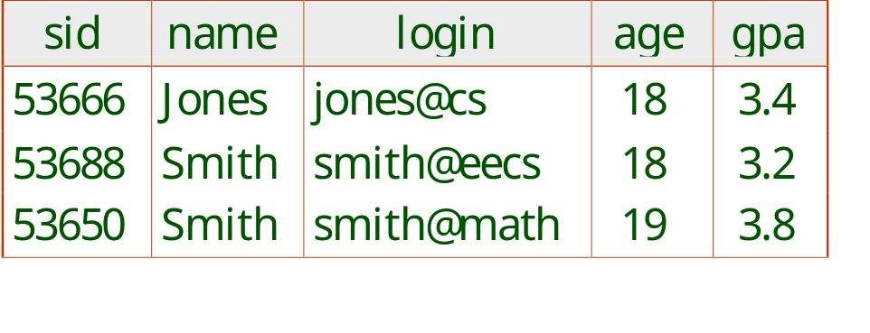
Foreign Keys in SQL
Only students listed in the Students relation should be allowed to enroll for courses
CREATE TABLE Enrolled
(sid CHAR(20), cid CHAR(20), grade CHAR(2),
PRIMARY KEY (sid,cid),
FOREIGN KEY (sid) REFERENCES Students )
Enrolled
Students
Notes:
7

Slide 30
Enforcing Referential Integrity
Consider Students and Enrolled; sid in Enrolled is a foreign key that references Students
What should be done if an Enrolled tuple with a non-existent student id is inserted? (Reject it!)
What should be done if a Students tuple is deleted?
  Also delete all Enrolled tuples that refer to it
  Disallow deletion of a Students tuple that is referred to
  Set sid in Enrolled tuples that refer to it to a default sid
  (In SQL, also: Set sid in Enrolled tuples that refer to it to a special value null, denoting `unknown’ or `inapplicable’) but sid is part of a primary key.
  Default is NO ACTION ie DELETE or UPDATE is rejected
Similar if primary key value of Students tuple is updated
Notes:
13

Slide 31
Referential Integrity in SQL
CREATE TABLE Enrolled
(sid CHAR(20),
cid CHAR(20),
grade CHAR(2),
PRIMARY KEY (sid,cid),
FOREIGN KEY (sid)
REFERENCES Students
ON DELETE CASCADE
ON UPDATE SET DEFAULT )
SQL/92 and SQL:1999 support all 4 options on deletes and updates
  Default is NO ACTION (delete/update is rejected)
  CASCADE (also delete all tuples that refer to deleted tuple)
  SET NULL / SET DEFAULT (sets foreign key value of referencing tuple)
  sid (CHAR (20) DEFAULT ‘53995’
Notes:
14

Slide 32
Where do ICs Come From?
ICs are based upon the semantics of the real-world enterprise that is being described in the database relations
We can check a database instance to see if an IC is violated, but we can NEVER infer that an IC is true by looking at an instance
  An IC is a statement about all possible instances!
Key and foreign key ICs are the most common; more general ICs supported too

Slide 33
Logical DB Design: ER to Relational
Entity sets to tables:
CREATE TABLE Employees
(ssn CHAR(11),
name CHAR(20),
lot INTEGER,
PRIMARY KEY (ssn))
name
ssn
lot
Employees
Notes:
3
The slides for this text are organized into several modules. Each lecture contains about enough material for a 1.25 hour class period. (The time estimate is very approximate--it will vary with the instructor, and lectures also differ in length; so use this as a rough guideline.) This covers Lectures 1 and 2 (of 6) in Module (5).
Module (1): Introduction (DBMS, Relational Model)
Module (2): Storage and File Organizations (Disks, Buffering, Indexes)
Module (3): Database Concepts (Relational Queries, DDL/ICs, Views and Security)
Module (4): Relational Implementation (Query Evaluation, Optimization)
Module (5): Database Design (ER Model, Normalization, Physical Design, Tuning)
Module (6): Transaction Processing (Concurrency Control, Recovery)
Module (7): Advanced Topics

Slide 34
ER Model Basics (2)
name
ssn
lot
since
Employees
name
dname
super-visor
subor-dinate
ssn
lot
did
budget
Works_In
Reports_To
Employees
Departments
Relationship: Association among two or more entities. E.g., Rajendra works in research & development department.
Relationship Set: Collection of similar relationships.
  An n-ary relationship set R relates n entity sets E1 ... En; each relationship in R involves entities e1 € E1, ..., en € En
    Same entity set could participate in different relationship sets, or in different “roles” in same set.

Slide 35
Relationship Sets to Tables
In translating a relationship set to a relation/table, attributes of the relation must include:
  Keys for each participating entity set (as foreign keys)
    This set of attributes forms a superkey for the relation
  All descriptive attributes
CREATE TABLE Works_In(
ssn CHAR(11),
did INTEGER,
since DATE,
PRIMARY KEY (ssn, did),
FOREIGN KEY (ssn)
REFERENCES Employees,
FOREIGN KEY (did)
REFERENCES Departments)
Notes:
5

Slide 36
Review: Key Constraints
since
name
dname
ssn
lot
did
budget
Each dept has at most one manager, according to the key constraint on Manages.
Employees
Manages
Departments
Translation to
relational model?
1-to-1
1-to Many
Many-to-1
Many-to-Many
Notes:
6

Slide 37
Department-Manages-Employee
CREATE TABLE Departments
(dname CHAR(20),
did INTEGER,
budget INTEGER,
PRIMARY KEY (did))
CREATE TABLE Employees
(ssn CHAR(11),
name CHAR(20),
lot INTEGER,
PRIMARY KEY (ssn))

Slide 38
Translating ER Diagrams with Key Constraints
CREATE TABLE Manages(
ssn CHAR(11),
did INTEGER,
since DATE,
PRIMARY KEY (did),
FOREIGN KEY (ssn) REFERENCES Employees,
FOREIGN KEY (did) REFERENCES Departments)
Map relationship to a table:
  Note that did is the key now!
  Separate tables for Employees and Departments
Since each department has a unique manager, we could instead combine Manages and Departments
CREATE TABLE Dept_Mgr(
did INTEGER,
name CHAR(20),
budget REAL,
ssn CHAR(11),
since DATE,
PRIMARY KEY (did),
FOREIGN KEY (ssn) REFERENCES Employees)
Notes:
7

Slide 39
Review: Participation Constraints
Does every department have a manager?
  If so, this is a participation constraint: the participation of Departments in Manages is said to be total (vs. partial).
    Every did value in Departments table must appear in a row of the Manages table (with a non-null ssn value!)
    Participation: every dept has manager
    Key: at most one manager
since
since
name
name
dname
dname
ssn
did
did
budget
lot
budget
Employees
Manages
Departments
Works_In
since
Notes:
8

Slide 40
Participation Constraints in SQL
We can capture participation constraints involving one entity set in a binary relationship
CREATE TABLE Dept_Mgr(
did INTEGER,
dname CHAR(20),
budget REAL,
ssn CHAR(11) NOT NULL,
since DATE,
PRIMARY KEY (did),
FOREIGN KEY (ssn) REFERENCES Employees,
ON DELETE NO ACTION)
Notes:
9

Slide 41
Contd…
On delete no action ….is default and need not be explicitly specified
Ensures that an Employee tuple can not be deleted while it is pointed to by a Dept-Mgr tuple
If we wish to delete that Employee tuple we first need to have a new employee as manager in Dept-Mgr
If we specify CASCADE instead of NO ACTION
  Deleting information about the department itself because the manager has been fired !!!!
The constraint that every dept has a manager cant be captured using first option (separate manages relation option)
If NOTNULL is added to ssn and did
  It would prevent firing a manager

Slide 42
Review: Weak Entities
A weak entity can be identified uniquely only by considering the primary key of another (owner) entity.
  Owner entity set and weak entity set must participate in a one-to-many relationship set (1 owner, many weak entities).
  Weak entity set must have total participation in this identifying relationship set.
name
ssn
lot
cost
pname
age
Employees
Policy
Dependents
Notes:
10

Slide 43
Translating Weak Entity Sets
Weak entity set and identifying relationship set are translated into a single table.
  When the owner entity is deleted, all owned weak entities must also be deleted.
CREATE TABLE Dep_Policy (
pname CHAR(20),
age INTEGER,
cost REAL,
ssn CHAR(11) NOT NULL,
PRIMARY KEY (pname, ssn),
FOREIGN KEY (ssn) REFERENCES Employees,
ON DELETE CASCADE)
Notes:
11

Slide 44
Reports-To Relationship Set
CREAT TABLE Reports-To(
supervisor_ssn CHAR(11),
subordinate_ssn CHAR(11),
PRIMARY KEY (supervisor_ssn,subordinate_ssn),
FOREIGN KEY (supervisor_ssn) REFERENCES Employees (ssn),
FOREIGN KEY (subordinate_ssn) REFERENCES Employees (ssn))

Slide 45
Review: ISA Hierarchies
name
ssn
lot
Employees
As in C++, or other PLs, attributes are inherited.
If we declare A ISA B, every A entity is also considered to be a B entity.
hourly_wages
hours_worked
ISA
contractid
Hourly_Emps
Contract_Emps
Overlap constraints: Can Joe be an Hourly_Emps as well as a Contract_Emps entity? (Allowed/disallowed)
Covering constraints: Does every Employees entity also have to be an Hourly_Emps or a Contract_Emps entity? (Yes/no)
Notes:
12

Slide 46
Translating ISA Hierarchies to Relations
General approach:
  3 relations: Employees, Hourly_Emps and Contract_Emps.
    Hourly_Emps:
      Every employee is recorded in Employees For hourly emps, extra info recorded in Hourly_Emps (hourly_wages, hours_worked, ssn)
      must delete Hourly_Emps tuple if referenced Employees tuple is deleted)
    Queries involving all employees easy, those involving just Hourly_Emps require a join to get some attributes.
Alternative: Just Hourly_Emps and Contract_Emps.
  Hourly_Emps: ssn, name, lot, hourly_wages, hours_worked.
  Each employee must be in one of these two subclasses.
Notes:
13

Slide 47
Review: Binary vs. Ternary Relationships
name
ssn
lot
pname
age
Employees
Covers
Dependents
What are the additional constraints in the 2nd diagram?
Bad design
Policies
policyid
cost
name
pname
age
ssn
lot
Dependents
Employees
Purchaser
Beneficiary
Better design
Policies
policyid
cost
Notes:
7

Slide 48
Translating to Relational Model
Deletion of Employee leads to deletion of all policies owned by employee and all dependents who are beneficiaries of those policies
Each dependent is required to have a covering policy (implicit NOT NULL)

Slide 49
Binary vs. Ternary Relationships (Contd.)
The key constraints allow us to combine Purchaser with Policies and Beneficiary with Dependents.
Participation constraints lead to NOT NULL constraints.
What if Policies is a weak entity set?
CREATE TABLE Policies (
policyid INTEGER,
cost REAL,
ssn CHAR(11) NOT NULL,
PRIMARY KEY (policyid).
FOREIGN KEY (ssn) REFERENCES Employees,
ON DELETE CASCADE)
CREATE TABLE Dependents (
pname CHAR(20),
age INTEGER,
policyid INTEGER,
PRIMARY KEY (pname, policyid).
FOREIGN KEY (policyid) REFERENCES Policies,
ON DELETE CASCADE)
Notes:
8

Slide 50
Aggregation
name
ssn
lot
Employees
Monitors
until
Used when we have to model a relationship involving (entitity sets and) a relationship set
  Aggregation allows us to treat a relationship set as an entity set for purposes of participation in (other) relationships
started_on
since
dname
pid
pbudget
did
budget
Projects
Sponsors
Departments
Aggregation vs. ternary relationship:
Monitors is a distinct relationship,
with a descriptive attribute
Also, can say that each sponsorship
is monitored by at most one employee
Notes:
2

Slide 51
Aggregation
Projects, Departments, Sponsors translated as discussed
  Projects( pid, started_on, pbudget)
  Departments (did, dname, budget)
  Sponsors ( pid,did,since)
Monitors ( until, pid, did, ssn)
Employee (ssn, name, lot)
Why Sponsors is required?
  To record descriptive attributes of Sponsor ( since)
  Not every sponsorship has a monitor and thus some (pid,did) pairs in sponsors may not appear in Monitors
If Sponsors
  has no descriptive attributes
  Has total participation in Monitors
Then every possible instance of Sponsors can be obtained from (pid,did) columns of Monitors (Sponsors can be dropped)

Slide 52
Views
A view is just a relation, but we store a definition, rather than a set of tuples]
From students and Enrolled relations
CREATE VIEW YoungActiveStudents (name, grade)
AS SELECT S.name, E.grade
FROM Students S, Enrolled E
WHERE S.sid = E.sid and S.age<21
Views can be dropped using the DROP VIEW command
  How to handle DROP TABLE if there’s a view on the table?
    DROP TABLE command has options to let the user specify this
Notes:
18

Slide 53
Updating Views
Updates to be specified only on views that are defined on a single base table (SQL 92) using just projection and selection, with no use of aggregate operations (updatable views)
    CREATE TABLE Good Students (sid,gpa)
    AS SELECT S.sid, S.gpa
    FROM Students S
    WHERE S.gpa > 9.0
    If view does not contain key of the base table, several rows in table would correspond to a single row in view
SQL 99 allows updates on views using more than one table where the PK of that table is included in the fields of view
Views defined using UNION, INTERSECT, EXCEPT cant be inserted into even if they are updatable

Slide 54
Insertion
If we insert a GoodStudents row by inserting a row into Students, using null values in columns of students that do not appear in GoodStudents(eg sams,login)
Note that PK columns are not allowed to contain null values
Therefore if we attempt to insert rows through a view that does not contain the PK of the underlying table, the insertions will be rejected

Slide 55
Views and Security
Views can be used to present necessary information (or a summary), while hiding details in underlying relation(s)
Given YoungStudents, but not Students or Enrolled, we can find students s who are enrolled, but not the cid’s of the courses they are enrolled in
Notes:
22

Slide 56
Relational Model: Summary
A tabular representation of data
Simple and intuitive, currently the most widely used
Integrity constraints can be specified by the DBA, based on application semantics. DBMS checks for violations
  Two important ICs: primary and foreign keys
  In addition, we always have domain constraints
Powerful and natural query languages exist
Rules to translate ER to relational model
Notes:
15

